Slide 1
Bike Store Management System
Course Name: Junior Design || Course Code: CSE 299 || Section: 07 || Group: 04
Git Repository: https://github.com/Nasim227/CSE299_Group-4.git
Group Members:
Md. Nasim Ahmed 2232936042
Md. Abir Hasan 2021833642
Md Murad Ul Momin 2232360642

Slide 2

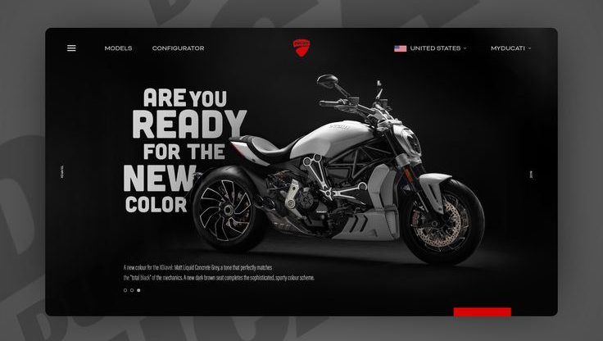

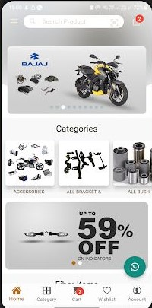
Bike Store Management System
The bike store management system is a web-based application for managing bike retail store activities. With this system delivery, we can automate everything from organizing the product, interacting with customers, sending stock alerts, generating invoices, and more. We are going to digitalize everything. The system will provide an enhanced UI/UX, data integrity, and easy access for customers and administrator users. The system can be used for better management of bike sales and inventory in an efficient manner while providing a high-quality experience to the customer without increasing the manual workload.

Slide 3

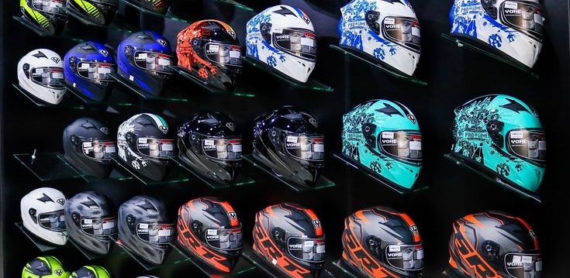
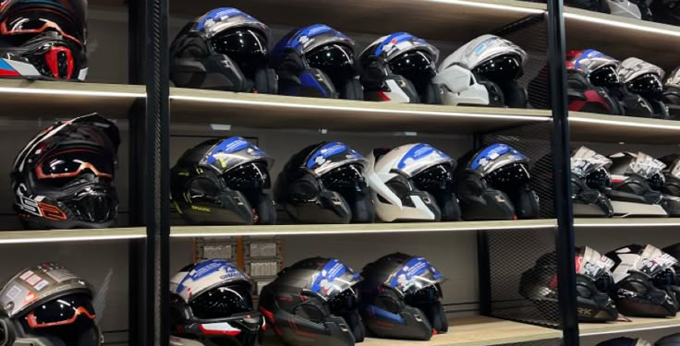
Project Overview
A web-based system to manage bike shop operations.
Automates product management, customer interaction, sales tracking, and report generation.
Aims to improve efficiency, reduce manual workload, and deliver better user experience.
Objectives
Create a dynamic and user-friendly bike shop website.
Build an efficient backend database system.
Enable modern features: bike view, product comparison, low stock alerts.
Integrate customer communication: email, WhatsApp.
Ensure accurate data through improved database architecture.

Slide 4
Navigation & User Interface
Clean dropdown navigation menu.
Responsive homepage layout.
Login/signup UI with background video.
Navigation bar with "More" options.
Social media links in expanded footer.
User Interaction & Feedback
Email & messaging APK integration.
WhatsApp interaction.
User suggestion & recommendation form.
Product review system.
Product & Inventory Management
Product comparison and filtering tools.
360° and multi-angle bike views.
Low stock alerts.
Company-wise product categorization.
Tables for total & current product inventory.
Additional Functional Features
Excel data export/import.
PDF invoice generation.
Shopping cart and personalized product suggestions.
Password change and session security.
New & Future Features
Multi-language support (English/Bangla).
Wishlist, recently viewed, real-time stock updates.
Live chat, SEO optimization.
QR code for product pages.
Admin analytics dashboard.

Slide 5



Technical Specifications
Frontend: HTML, CSS, JS, Bootstrap, Tailwind
Backend: PHP / Node.js / Java
Database: MySQL / PostgreSQL
Tools: jQuery, Chart.js, ExcelJS, PDF API
IDE: Visual Studio Code

Slide 6



Expected Outcomes
Fully functional bike shop web system.
Admin/customer dashboards.
Real-time inventory and sales reports.
Enhanced user experience and performance.
Future Enhancements
Online payments (SSLCommerz, Bkash, Nagad).
Mobile app version.
AI-powered recommendations.
Chatbot and business analytics features.

Slide 7
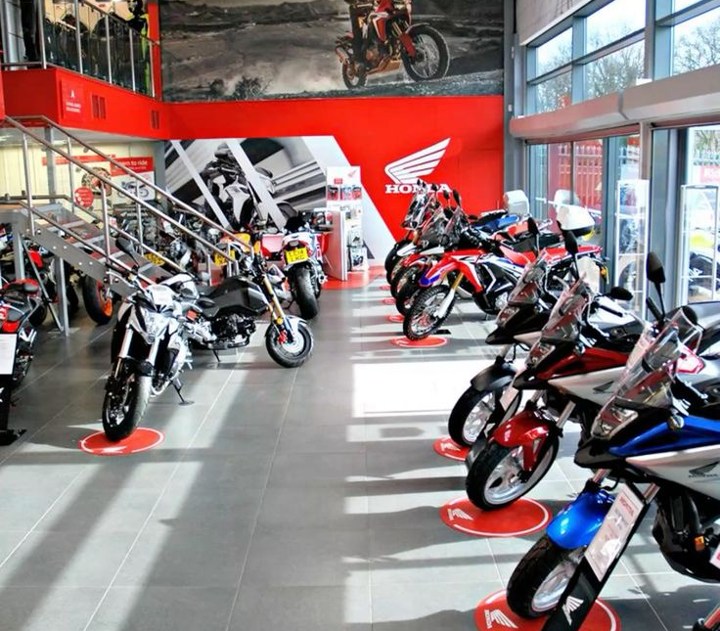
Conclusion
Our system transforms traditional bike stores into efficient, digital platforms.
Supports small businesses in Bangladesh with automation.
Scalable and adaptable for future technologies.

Slide 8
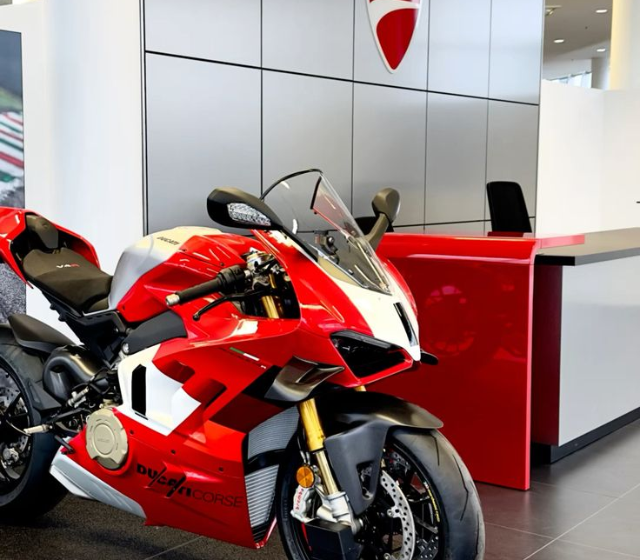
Thank you!
Any Questions?

